Slide 1
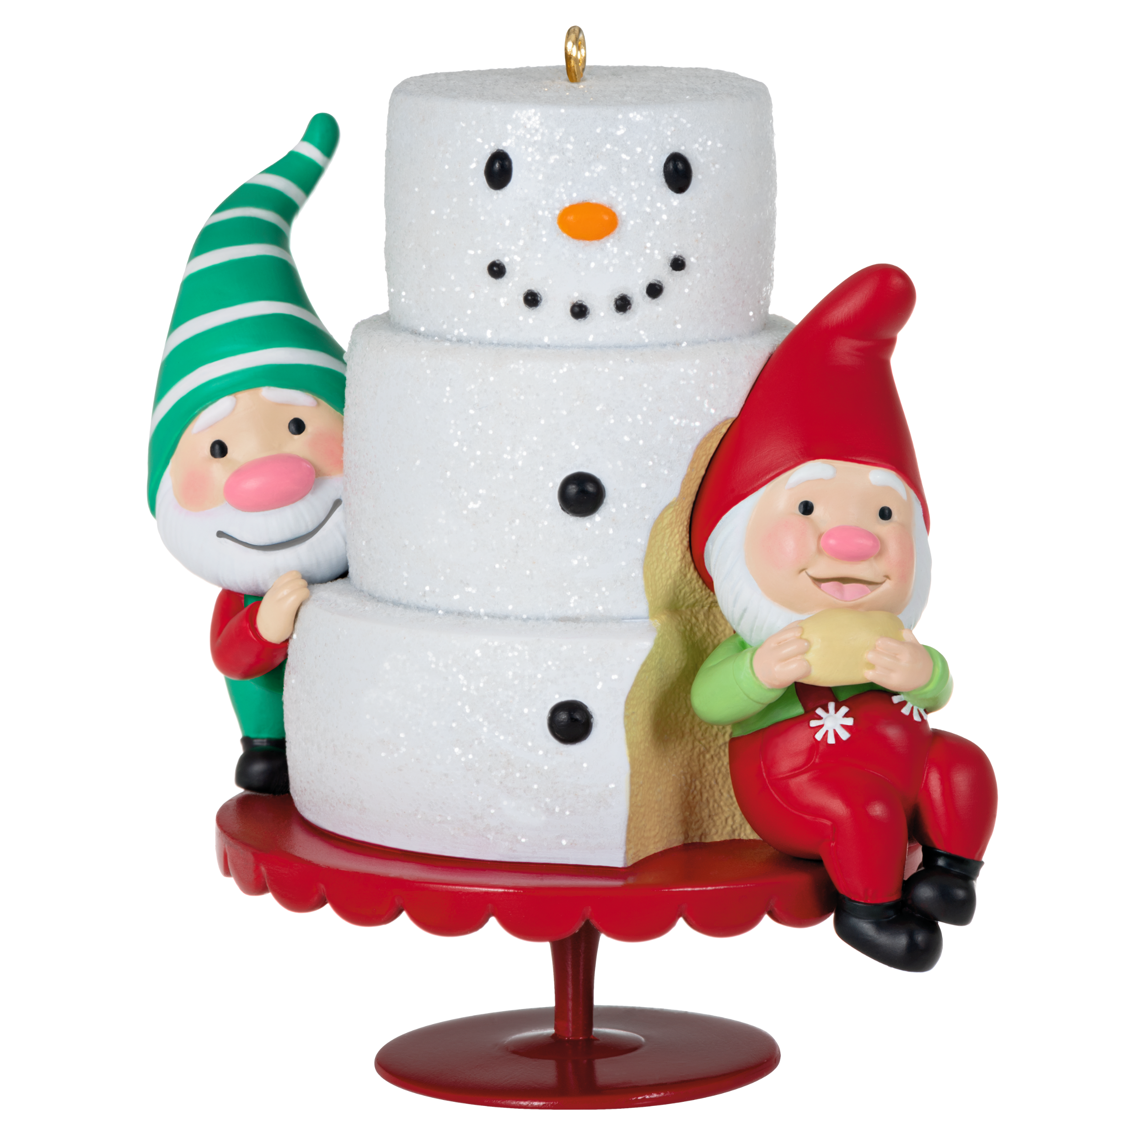
What are the names of the characters featured on the new first-in-series ornament,
Gnome For Christmas?
TIME FOR TRIVIA!
Notes:
Gnaughty and Gnice

Slide 2
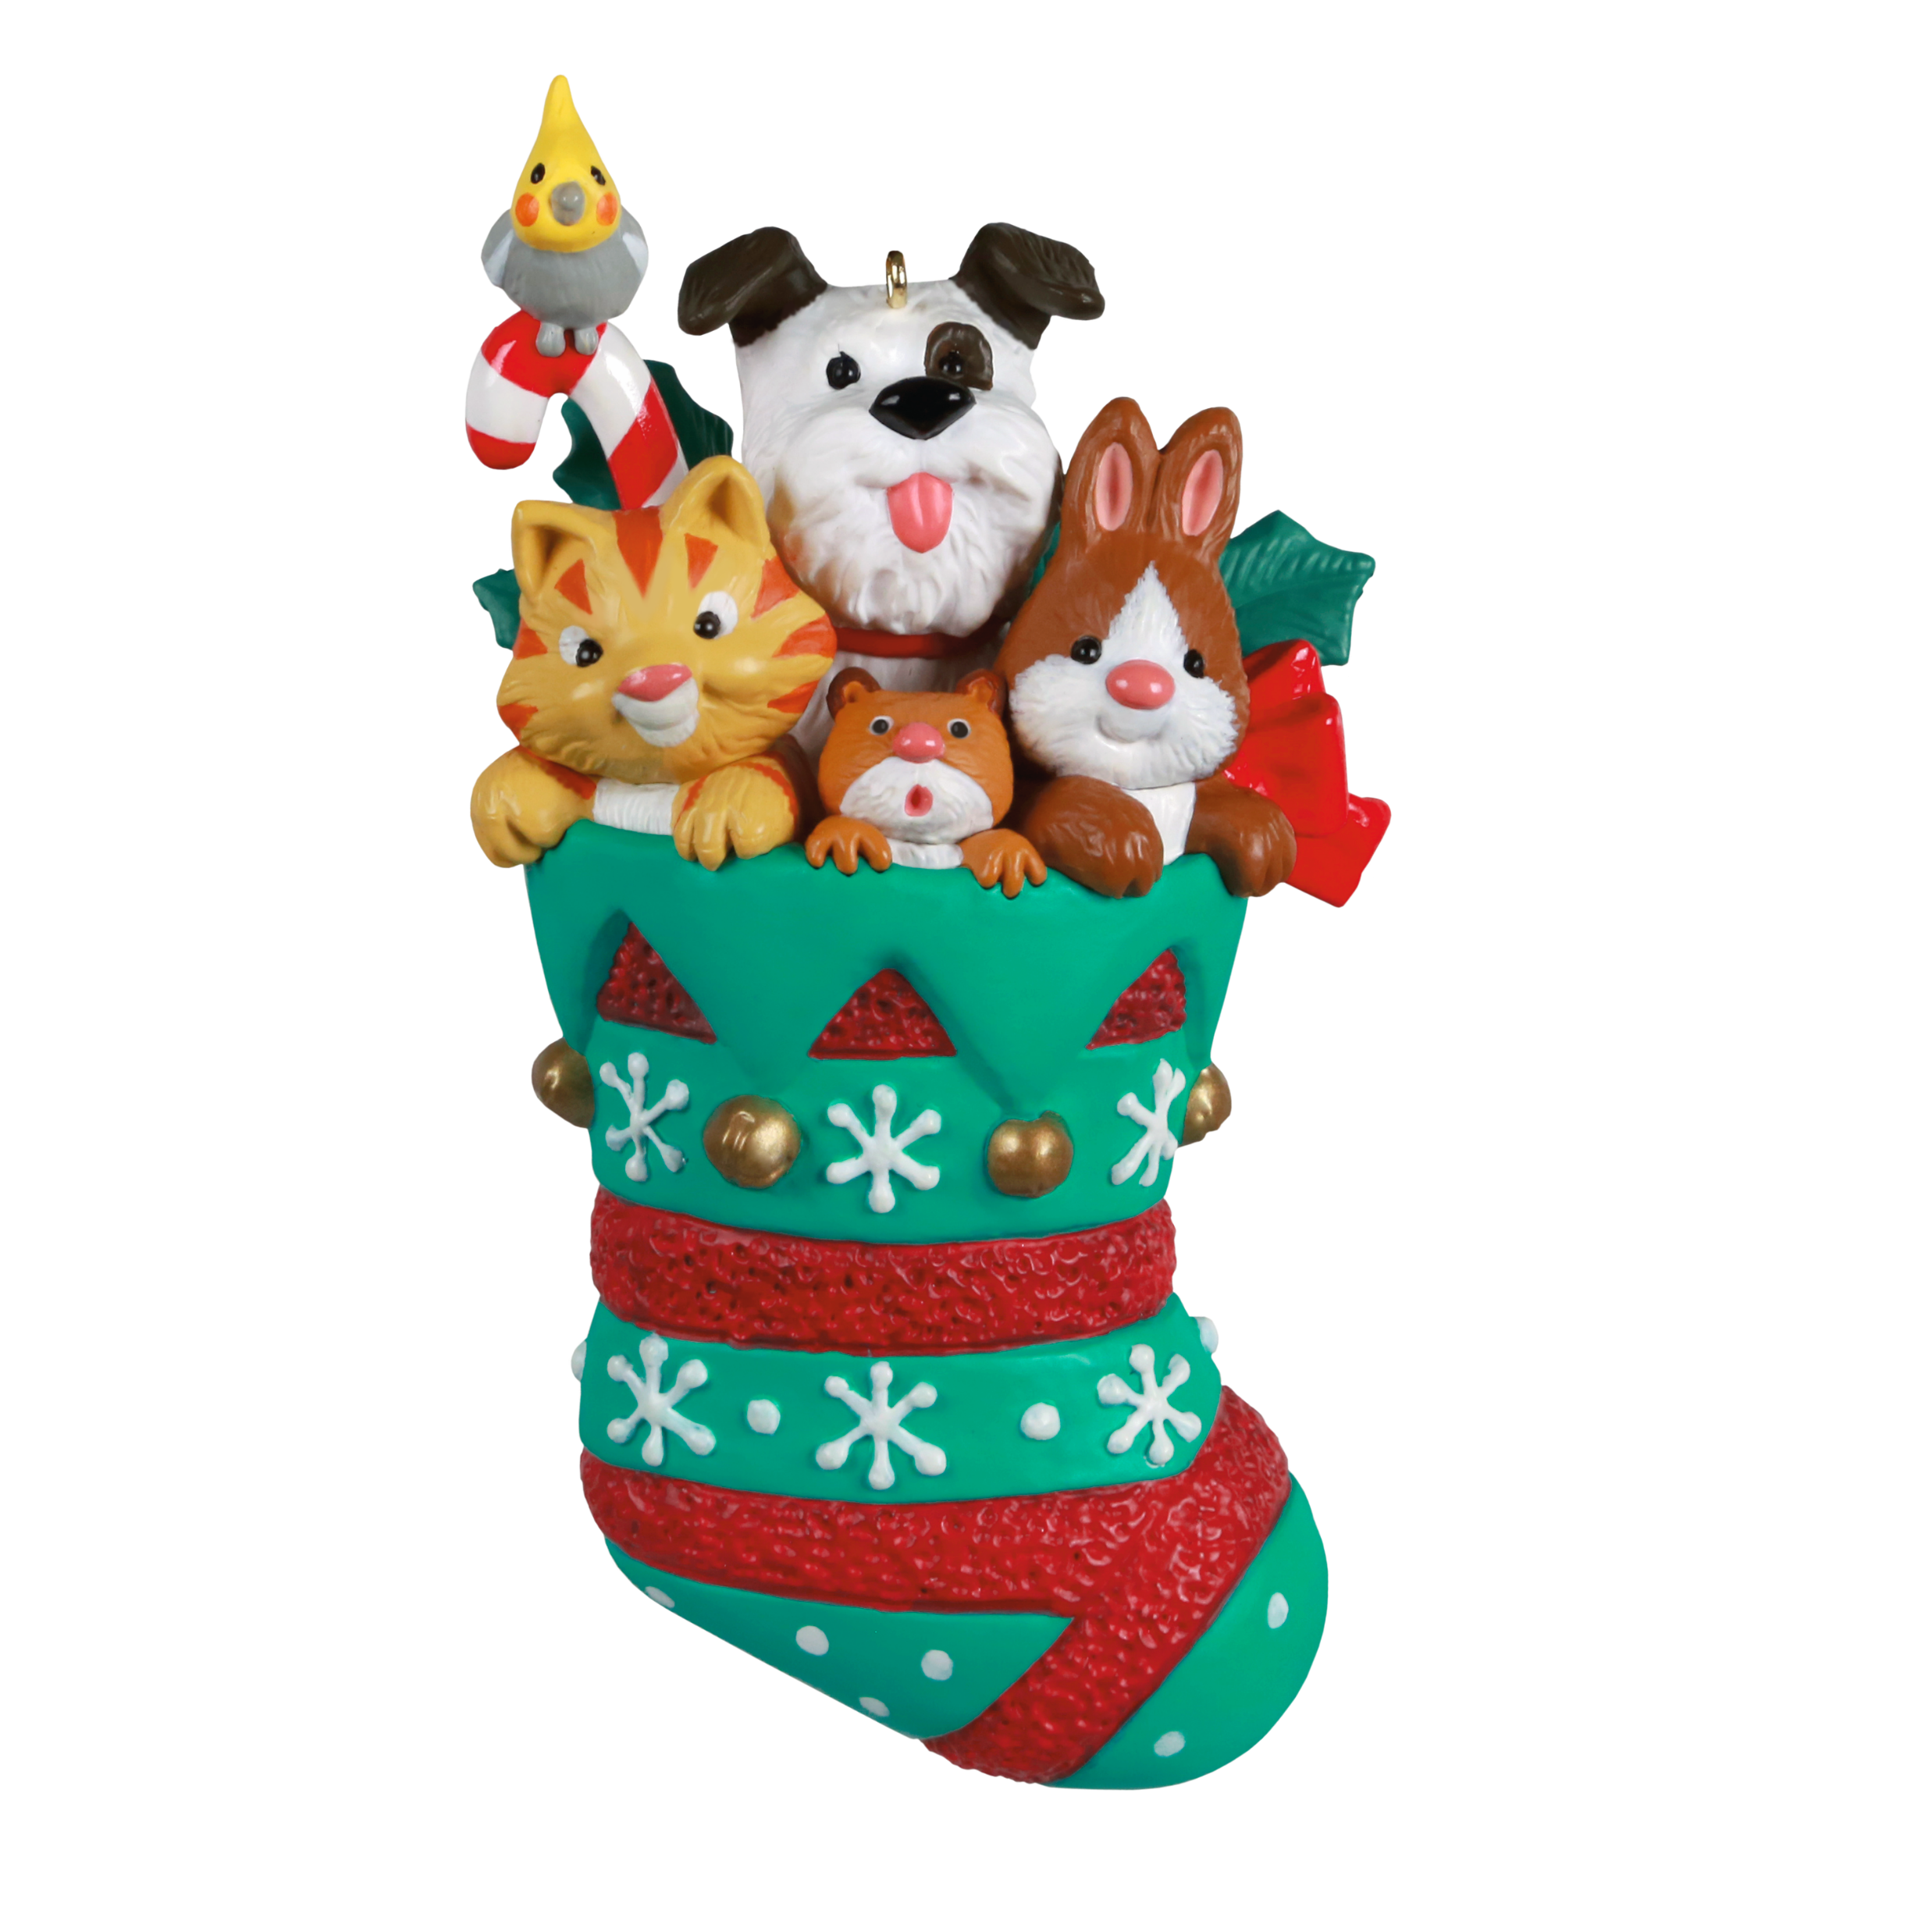
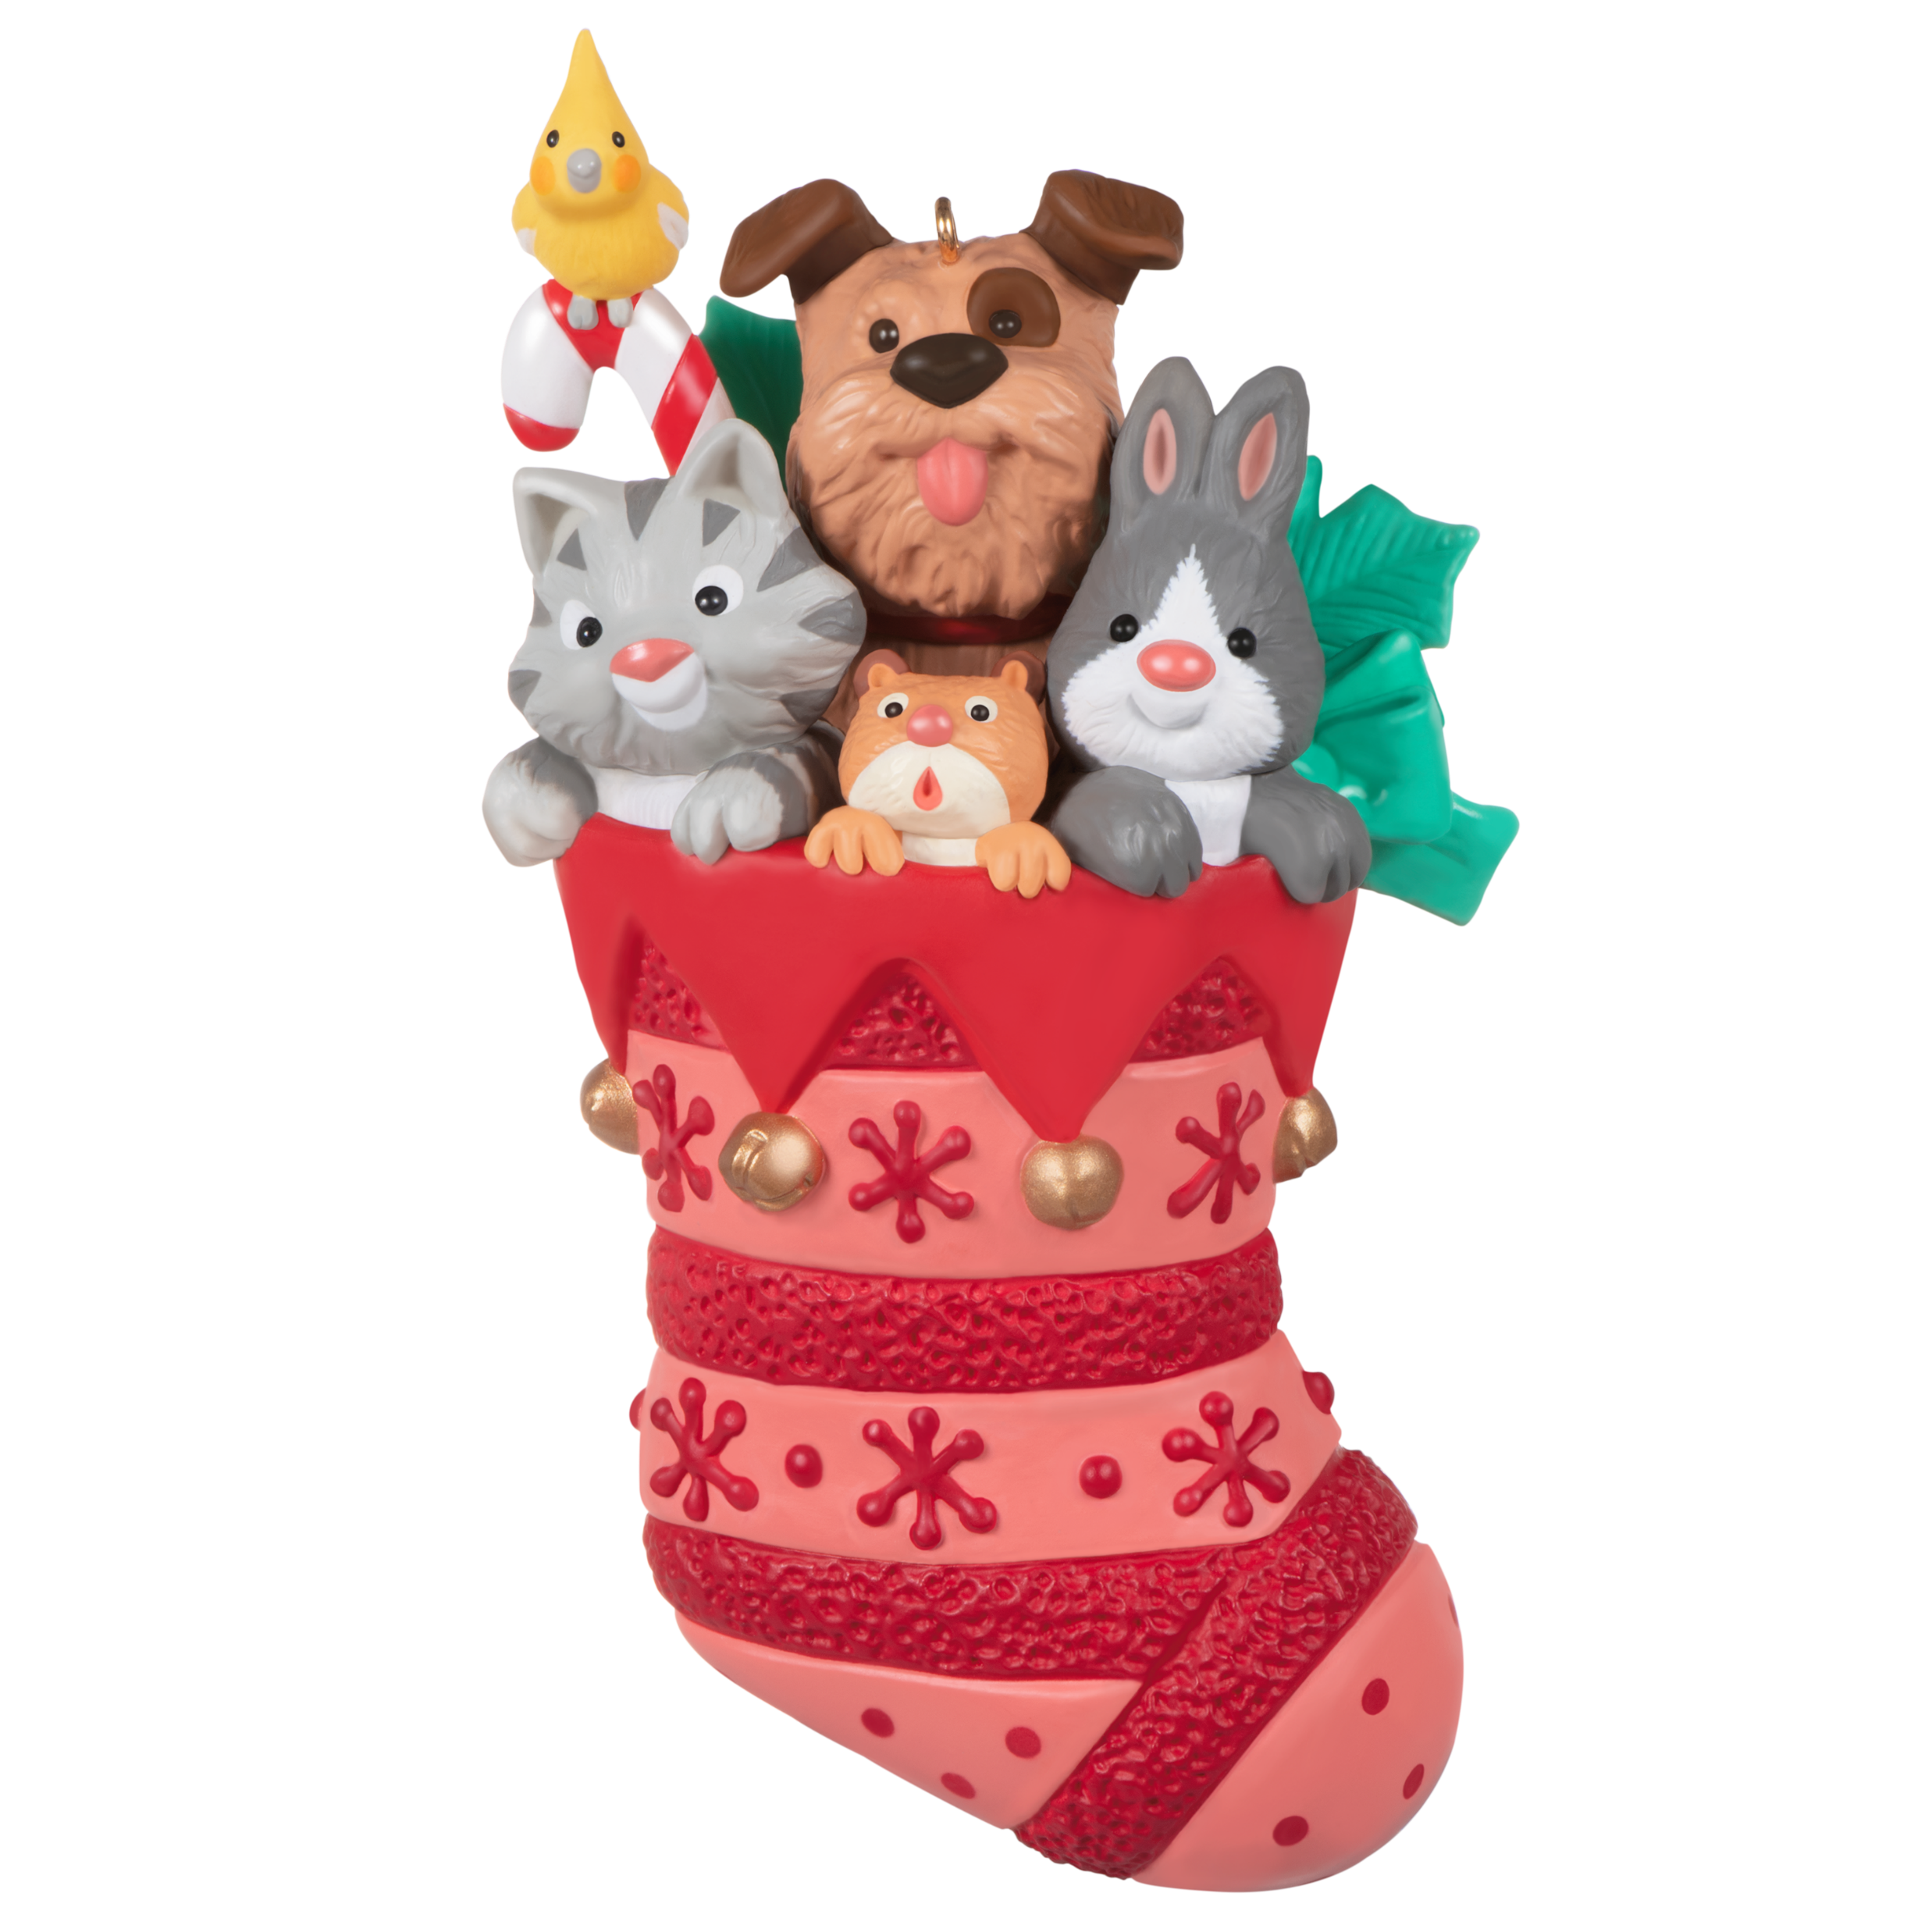
Did you know?
A repaint of he new first-in-series ornament, Stocking Stuffers, will be available as a promotion during the Ornament Debut event!
TIME FOR TRIVIA!
Notes:
Click to make the repainted ornament image appear.

Slide 3

Which version of Mickey Mouse is featured in the final-in-series, Mickey’s Movie Mouseterpieces?
TIME FOR TRIVIA!
Notes:
Steamboat Willie

Slide 4
Artist corner

Slide 5

Featured artist
Tammy Haddix
Notes:
Tammy Haddix has been drawing for as long as she can remember. Her mother was the first to discover Tammy's talent at an early age.
Unfortunately, her mom found it on countertops and in closets. The kitchen projects were washed away, but the closet creations were another story. Her mom, an artist herself, loved them so much that the artwork stayed up for decades.
It didn't take long for little Tammy to decide on her career goals. When she was 5 years old, her mother took her along to a Hallmark store. Tammy was so impressed by all the beautiful artwork that she declared her intention to work for Hallmark right then and there.

Slide 6
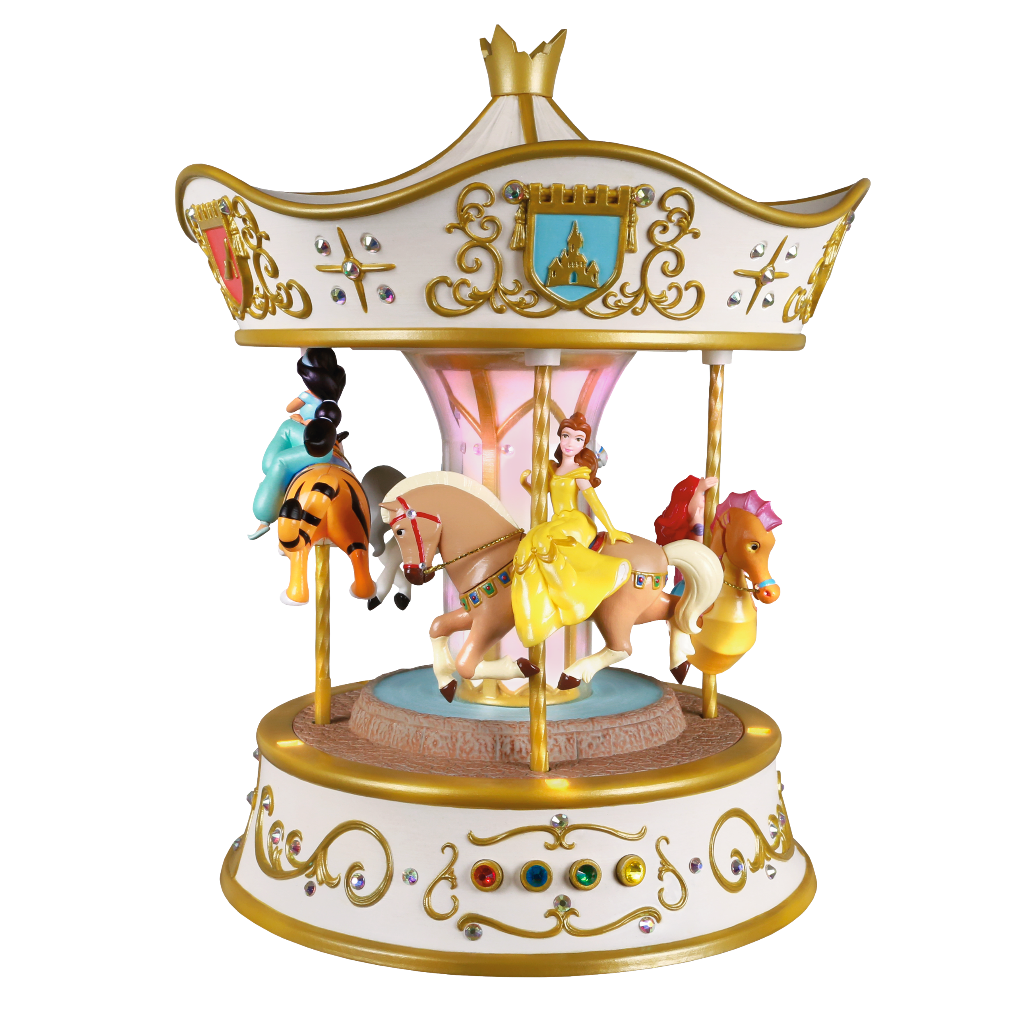
Did you know?
The four colored jewels on the Dreams Go Round Carousel are buttons to play each of the four songs.
TIME FOR TRIVIA!
Notes:
The four songs are:
A Dream Is a Wish Your Heart Makes
Part of Your World
Beauty and the Beast
A Whole New World!

Slide 7
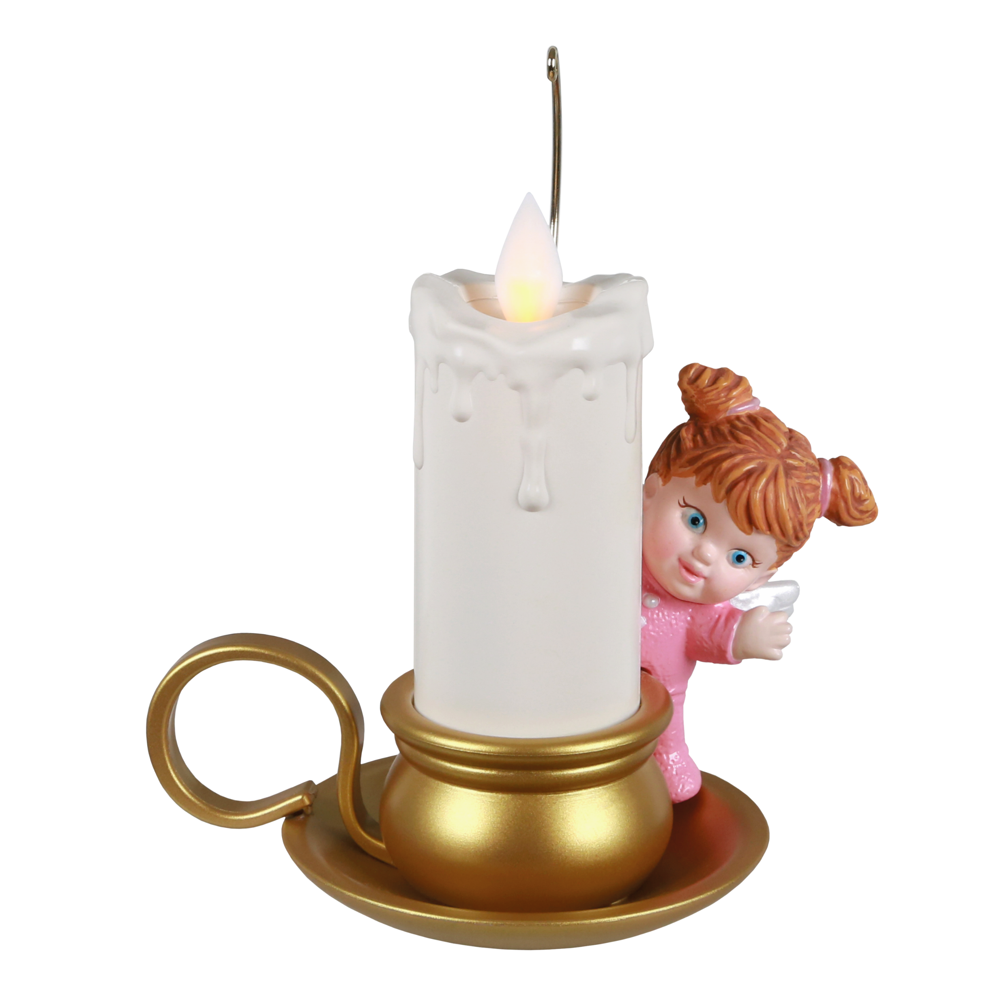
What is the special feature of the Angelic Candlelight ornament?
TIME FOR TRIVIA!
Notes:
The technology creates a realistic flickering flame.

